Slide 1
Editable cards for siblings for sickness and bereavement
When you have edited them you can save them as a picture file and then print as appropriate or use a printing service such as Vistaprint. You can personalize with name or use brother, sister, or sibling as appropriate.

Slide 2
Thinking of you
We are so sad to hear that your brother has died. We are thinking of you as you feel so sad and send our love and prayers

Slide 3
Thinking of you
We are so sad to hear that your sister has died. We are thinking of you as you feel so sad and send our love and prayers

Slide 4
Thinking of you
We are so sad to hear that your sibling has died. We are thinking of you as you feel so sad and send our love and prayers

Slide 5
Thinking of you
We are so sad to hear that your brother has died.
We are thinking of you and send our love and prayers

Slide 6
Thinking of you
We are so sad to hear that your sister has died.
We are thinking of you and send our love and prayers

Slide 7
Thinking of you
We are so sad to hear that your sister has died.
We are thinking of you and send our love and prayers

Slide 8
Thinking of you
We are so sad to hear that your brother has died.
We are thinking of you and send our love and prayers

Slide 9
We are
so sad
to hear that
your sister
has died.
Thinking of you
We send
our love and prayers
to you

Slide 10
Thinking of you
We are so sad to hear that your sibling has died.
We are thinking of you and send our love and prayers
From

Slide 11
Thinking of you
We are so sad to hear that your brother has died. We send our love and prayers to you.
From

Slide 12
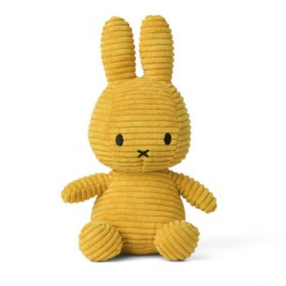
Thinking of you
We are so sad to hear that your sister is sick.
We are thinking of you and send our love and prayers
From

Slide 13
Thinking of you
We are so sad to hear that your sister is sick.
We are thinking of you and send our love and prayers
From

Slide 14
Thinking of you
We are so sad to hear that your brother is sick
We are thinking of you and send our love and prayers

